Slide 1
Integrating Project-Based Science Learning into Lessons(Pedagogy)
By Semiha G Yildiz
Notes:
Hello everyone, and welcome!
I’m so happy to see you all here today, and honestly, I’m very excited.
I truly hope we’ll have a wonderful and productive year together.
What I’ve observed is that our classes are very rich in content — teachers are doing a wonderful job in terms of subject knowledge.
However, when it comes to pedagogy, I’ve realized that while instruction is solid, it doesn’t always fully reflect the most recent research and practices in science education.
Based on my observations, almost all of the science classes at TMSA will move into the critical change phase, except for the 5th grade. And I want to thank you all for your hard work and dedication.

Slide 2
Hands-On Learning
What it is:
Students learn by doing — manipulating materials, conducting experiments, and participating actively.
The goal is engagement and experience.
“Tell me and I forget, show me and I may remember, involve me and I UNDERSTAND.”
Example:
Students test how a ball rolls on different surfaces to observe friction.
Limitation:
Students may do something without deeply thinking about why it happens.
The activity is active but not always meaningful.
Hands-on ≠ always minds-on.
Notes:
Understanding is not enough in science classrooms — I’ll tell you a bit more about that in a moment.
So in this example, what students are practicing?----
Their thinking is limited in these hands on practice.

Slide 3
Not Every Lesson Needs to Be Hands-On,
But Every Lesson Must Be Minds-On.
Notes:
From now on, we are moving away from hands-on learning as a primary strategy.
At TMSA, we no longer want to hear “hands-on learning” used as an instructional focus.
The Central Office’s expectation is to shift toward minds-on, project-based, and reasoning-centered science teaching.

Slide 4
Inquiry-Based Learning
Students learn through questioning, investigating, collecting evidence, and reasoning.
They think like scientists — asking why and how instead of just what.
Students ask, “Why do plants bend toward light?” then design and conduct an experiment to find out.
Strength:
Promotes scientific reasoning and curiosity
Encourages evidence-based explanations
Notes:
So here we have skills or practice like thinking, reasoning, asking why and how questions, but still we have sth missing which is very important.
Lets look at here so we will see what is missing in inquiry based learning.
Bu kismi bu slayt a 2. sefer dondugunde sole:
Limitation:
Often short-term or focused on a single concept
May not always connect directly to real-world contexts

Slide 5
What is Science?
Notes:
How do you define it?

Slide 6
Science is MAKING SENSE of the things that are happening in the world.
Notes:
Let’s dive a bit deeper into this idea and see what each part really means.
Science is not just a collection of facts or formulas — it is a way of thinking and making sense of the world. It is the human process of observing patterns, asking questions, testing ideas, and using evidence to explain how things work.
True science happens when curiosity meets reasoning. It empowers learners to move from wondering to understanding, from observing to explaining, and from knowing to applying. They know so much but when it comes to applying, they fail.
In education, science is not about giving students the right answers, but about helping them develop the habits of mind — questioning, reasoning, experimenting, and reflecting — that allow them to construct meaning for themselves.
I looked at the EOG questions and the standards, and from my analysis, it’s clear that students really need to operate at a make-sense level, not just recall or memorization.

Slide 7
Wondering to Understanding,
Observing to Explaining,
Knowing to Applying
Notes:
FROM TO
Our studnets know so much but when it comes to applying, they fail.

Slide 8
Understanding = being able to explain clearly → the product of learning
Sense Making = forming your own meaning → the process of understanding
Notes:
Do you see the difference?
If students never reach the make sense level, true problem solving ability or innovation, design thinking cannot emerge. They might understand things in a general way, but they will think and act just like everyone else — doing what’s expected, not what’s original.
What we want is to raise a generation of learners who can look at the world’s problems from different perspectives and create unique solutions — individuals who can think beyond what already exists and imagine what could be.

Slide 9
Project-Based Learning (PBL)
What it is:
Students work on authentic, real-world problems over an extended period.
They research, test, build, and create a product or solution using science concepts.
Inquiry is part of the process — but PBL goes further by applying learning to real life.
Example:
Students design a system to reduce energy waste at school.
They research energy transfer (inquiry), test materials (hands-on), and apply their findings in a real design (PBL).

Slide 10
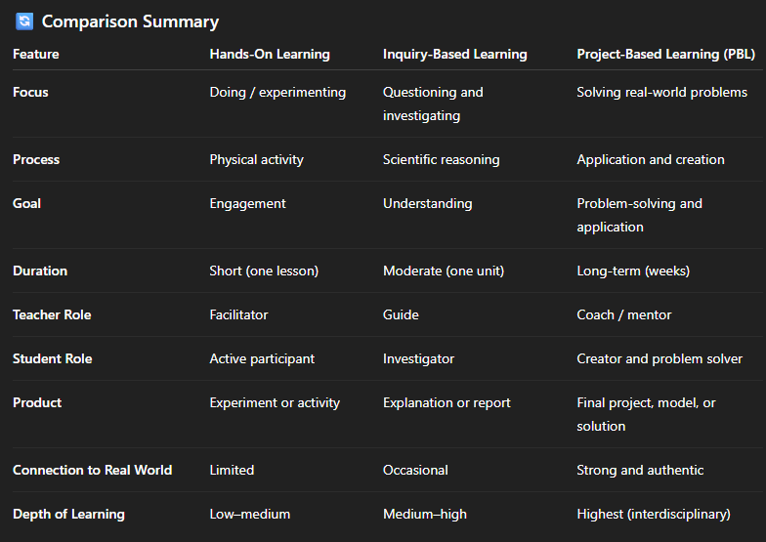
Notes:
In Summary
Hands-on: Students do.
Inquiry-based: Students think and investigate.
Project-based: Students apply, solve, and create.
🔹 Hands-on = experience
🔹 Inquiry-based = reasoning
🔹 Project-based = application + creation

Slide 11
Hands-On Learning
Activity:
Students touch and observe ice, water, and steam (using safe visuals or warm water).
They describe how each feels and looks.
Focus: Experiencing and observing the three states.
Teacher says: “Let’s explore how solids, liquids, and gases look and feel.”
Learning Outcome: Students can identify the three states based on what they see and touch.
Notes:
Unfortunately, my camera isn’t placed on the big screen, so you’ll be seeing me from the side. I need to get a camera that sits on top of the main screen.
Hello everyone, and welcome!
I’m so happy to see you all here today, and honestly, I’m very excited.
I truly hope we’ll have a wonderful and productive year together.
Well, you see me in the classroom bc I decided to start with the observations since this is my first year at TMSA, and at the beginning, I had no clear idea about how the science classes were structured at TMSA.
Now I’ve almost completed observations in all eight schools
What I’ve observed is that our classes are very rich in content — teachers are doing a wonderful job in terms of subject knowledge.
However, when it comes to pedagogy, I’ve realized that while instruction is solid, it doesn’t always fully reflect the most recent research and practices in science education.
Based on my observations, almost all of the science classes at TMSA will move into the critical change phase, except for the 5th grade. And I want to thank you all for your hard work and dedication.

Slide 12
Inquiry-Based Learning
Activity:
Students ask, “What makes ice melt?”
They test how heat changes the state of matter by placing ice in different conditions (room temp, fridge, sunlight).
They record observations and make explanations.
Focus: Investigating why matter changes state.
Teacher says: “What do you think will happen if we put ice in the sun? Why?”
Learning Outcome: Students reason that temperature affects how matter changes states.
Notes:
Unfortunately, my camera isn’t placed on the big screen, so you’ll be seeing me from the side. I need to get a camera that sits on top of the main screen.
Hello everyone, and welcome!
I’m so happy to see you all here today, and honestly, I’m very excited.
I truly hope we’ll have a wonderful and productive year together.
Well, you see me in the classroom bc I decided to start with the observations since this is my first year at TMSA, and at the beginning, I had no clear idea about how the science classes were structured at TMSA.
Now I’ve almost completed observations in all eight schools
What I’ve observed is that our classes are very rich in content — teachers are doing a wonderful job in terms of subject knowledge.
However, when it comes to pedagogy, I’ve realized that while instruction is solid, it doesn’t always fully reflect the most recent research and practices in science education.
Based on my observations, almost all of the science classes at TMSA will move into the critical change phase, except for the 5th grade. And I want to thank you all for your hard work and dedication.

Slide 13
Project-Based Learning (PBL)
Driving Question:
“How can we keep our drinks cold for a picnic on a hot day?”
Project:
Students design and test a container that keeps ice from melting quickly.
They apply what they know about solids, liquids, gases, and insulation.
Focus: Applying science knowledge to solve a real-world problem.
Teacher says: “What kind of material would keep the ice solid longer? Let’s design and test!”
Learning Outcome: Students use scientific understanding to design and improve a real solution.
Notes:
Unfortunately, my camera isn’t placed on the big screen, so you’ll be seeing me from the side. I need to get a camera that sits on top of the main screen.
Hello everyone, and welcome!
I’m so happy to see you all here today, and honestly, I’m very excited.
I truly hope we’ll have a wonderful and productive year together.
Well, you see me in the classroom bc I decided to start with the observations since this is my first year at TMSA, and at the beginning, I had no clear idea about how the science classes were structured at TMSA.
Now I’ve almost completed observations in all eight schools
What I’ve observed is that our classes are very rich in content — teachers are doing a wonderful job in terms of subject knowledge.
However, when it comes to pedagogy, I’ve realized that while instruction is solid, it doesn’t always fully reflect the most recent research and practices in science education.
Based on my observations, almost all of the science classes at TMSA will move into the critical change phase, except for the 5th grade. And I want to thank you all for your hard work and dedication.

Slide 14
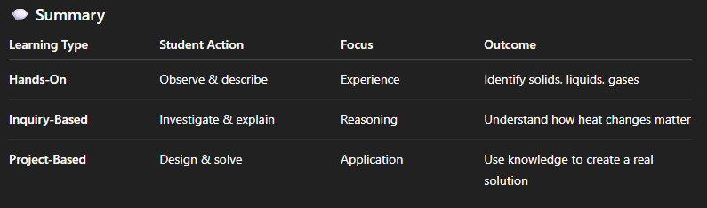
Notes:
In Summary
Hands-on: Students do.
Inquiry-based: Students think and investigate.
Project-based: Students apply, solve, and create.
🔹 Hands-on = experience
🔹 Inquiry-based = reasoning
🔹 Project-based = application + creation
For creating a driving question, you don’t even need to spend much time thinking on your own — you can get quick support from AI tools like ChatGPT.
Simply type something like:
“I’m planning a project-based learning lesson on X topic. Can you help me write a driving question for it?”
Within seconds, AI will suggest several high-quality, open-ended questions that you can adapt to your students’ grade level and context.
💡 Example:
“I’m doing a project-based learning lesson on weather patterns. Can you suggest a driving question for 4th graders?”
AI might give you:
🌦️ “How can we help our community prepare for extreme weather?”
🌪️ “Why does the weather change, and how can we predict it?”

Slide 15
One question for each approach — three questions total.
1. Hands-On
2. Inquiry Based
3. Project Based
Notes:
I’d like you to take about five minutes to think about this.
For a given topic, imagine how it would look if it were taught as hands-on, inquiry-based, and project-based.
Please come up with one question for each approach — three questions total. Like driving question or the goal of the lesson for you.
Take your time and think carefully, because this practice will really help you when designing your future lessons.

Slide 16
Key idea:
Students learn science by doing science. - Moves from teacher-centered → student-driven learning - Builds critical thinking, problem-solving, collaboration, and creativity - Makes learning authentic through real-world challenges
Example: Instead of memorizing the water cycle, students design solutions to reduce water waste in their community.
Notes:
With your team, we’ll be able to start directly from the improvement phase — which is great!
So Since I’ve done most of my research on science pedagogy, I’m quite familiar with current educational practices and approaches, and I’d really love for us to explore and improve these together.
For that reason, today I’d like to briefly share a few ideas about some common misconceptions and educational theories — just short insights that might help us connect our strong content knowledge with the most effective instructional strategies.
Today’s meeting is meant to clear up a few common pedagogical misconceptions and start a shared discussion about what effective science teaching really looks like.
After this, we’ll continue working together in person — continue visiting classrooms, collaborating, and supporting each other in practice.

Slide 17
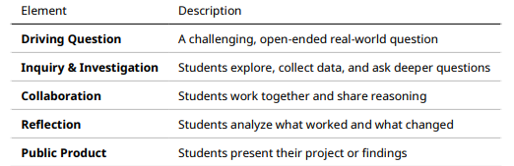
Core Elements of PBL
Notes:
We already have strong content, so our curriculum work will mainly focus on pedagogy — how we teach and how students experience learning instead of what we teach.

Slide 18
Why Integrate Science into PBL?
Science naturally fits PBL because: - It’s based on curiosity and evidence
--Encourages hands-on investigation
--Connects to real-world phenomena
--Strengthens conceptual understanding through application
Goal: Move beyond memorizing facts to making sense of the world scientifically.
Notes:
Difference between
What comes to your mind
when you hear hands on and minds on.

Slide 19
Lesson Example – How Can We Keep Our School Cooler in the Summer?
Grade Level: 5th–6th
Time: 3–4 class periods
Focus: Heat transfer, insulation, energy efficiency
Driving Question: How can we design a classroom that stays cooler in summer using what we know about heat and energy?
Activities:
Observe two metal spoons in hot water (one wrapped, one not). Discuss why.
Test different materials (foil, fabric, plastic) for insulation.
Design and test classroom models under light to measure temperature change.
Reflect on which design worked best and why.
Outcome: Students apply scientific reasoning to solve an authentic problem
Notes:
Which strategy is more effective for science learning? And why
Which strategy do you use most often in your classroom? And why
In the first example, students were physically active — they touched the toaster, followed directions, and completed a task. But their thinking was limited. They were simply following steps, not exploring concepts or reasoning scientifically.
In the second scenario, even though students didn’t touch anything, they were actively engaged in thinking. They observed, questioned, and connected ideas.
That’s where real science learning begins — in the process of sensemaking, not just doing.
So, the key takeaway is this:
A truly effective science lesson is not about how much students do with their hands, but how deeply they think with their minds.
We can’t expect students to truly engage in solving real-world problems if everything they do follows a ready-made “recipe experiment.” They need to talk, think, and develop that sense of agency. For every global issue, teachers can’t simply hand them a fixed set of steps — we have to trust their knowledge and potential.
Are we really teaching students things they know nothing about — completely new ideas they’ve never experience before?
Or are we actually creating spaces where they can make sense of things they’ve already experienced, but haven’t yet fully understood?
Students often learn about topics at school that they’ve already experience in their daily lives — but without fully understanding them yet. For example:
Weather and Climate: They experience rain, wind, and temperature changes every day, but at school they learn to explain these patterns scientifically.
Forces and Motion: Riding a bike, kicking a ball, or jumping are all experiences connected to Newton’s laws — they already know the actions, but now they learn the “why” behind them.
States of Matter: They’ve seen ice melt or water boil at home; science helps them make sense of these familiar phenomena.
Energy: From charging a phone to feeling tired after running, they experience energy transfer constantly.
Problem Solving and Design Thinking: When they try to fix a toy or build with Legos, they’re already engaging in the engineering process.
So, in many ways, we are not teaching students things they’ve never seen before. Instead, we’re helping them make sense of what they already know.

Slide 20
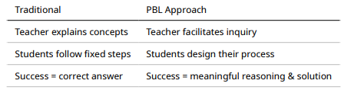
Teacher’s Role in PBL Science
Notes:
Progression of Science Learning
1️⃣ First Image – Hands-On Exploration
Students are engaged in hands-on investigation, exploring phenomena through observation and manipulation. This stage is research-based and driven by curiosity — students are discovering patterns and making sense of what they see.
2️⃣ Second Image – Guided (Recipe) Lab
Here, students are working under teacher direction, following a step-by-step process — a recipe lab. It’s structured and controlled by the teacher, helping students connect what they explored earlier to formal scientific procedures.
3️⃣ Third Image – Real-World Application / Design
In this phase, students use their scientific knowledge to solve real-world problems. They apply what they have learned to design, innovate, or propose solutions — demonstrating true understanding and creativity in using science beyond the classroom.
So, if we had to take one of these out, which do you think doesn’t really fit with current research?
Difference Between the First and Last Image
The first image shows students repeating something that has already been done, using science to understand and replicate existing ideas or experiments.
In contrast, the last image shows students applying their scientific knowledge to create solutions for real-world problems — moving from understanding science to applying science to make a difference.
I’ll come back here.

Slide 21
Teacher Moves:
- Ask: "What makes you think that?"
- Encourage multiple solutions
- Scaffold reasoning, not answers
Notes:
How do you define it?

Slide 22
Assessment in PBL Science
Rubric Focus:
Application of knowledge, not recall
Scientific reasoning & evidence use
Creativity and reflection - Collaboration and communication
Notes:
Progression of Science Learning
1️⃣ First Image – Hands-On Exploration
Students are engaged in hands-on investigation, exploring phenomena through observation and manipulation. This stage is research-based and driven by curiosity — students are discovering patterns and making sense of what they see.
2️⃣ Second Image – Guided (Recipe) Lab
Here, students are working under teacher direction, following a step-by-step process — a recipe lab. It’s structured and controlled by the teacher, helping students connect what they explored earlier to formal scientific procedures.
3️⃣ Third Image – Real-World Application / Design
In this phase, students use their scientific knowledge to solve real-world problems. They apply what they have learned to design, innovate, or propose solutions — demonstrating true understanding and creativity in using science beyond the classroom.
So, if we had to take one of these out, which do you think doesn’t really fit with current research?
Difference Between the First and Last Image
The first image shows students repeating something that has already been done, using science to understand and replicate existing ideas or experiments.
In contrast, the last image shows students applying their scientific knowledge to create solutions for real-world problems — moving from understanding science to applying science to make a difference.
I’ll come back here.

Slide 23
Sample Rubric Dimensions:
1. Scientific understanding
2. Application of concept
3. Critical thinking
4. Creativity & innovation
5. Communication & teamwork
Notes:
Do you see the difference?
If students never reach the make sense level, true problem solving ability or innovation cannot emerge. They might understand things in a general way, but they will think and act just like everyone else — doing what’s expected, not what’s original.
What we want is to raise a generation of learners who can look at the world’s problems from different perspectives and create unique solutions — individuals who can think beyond what already exists and imagine what could be.

Slide 24
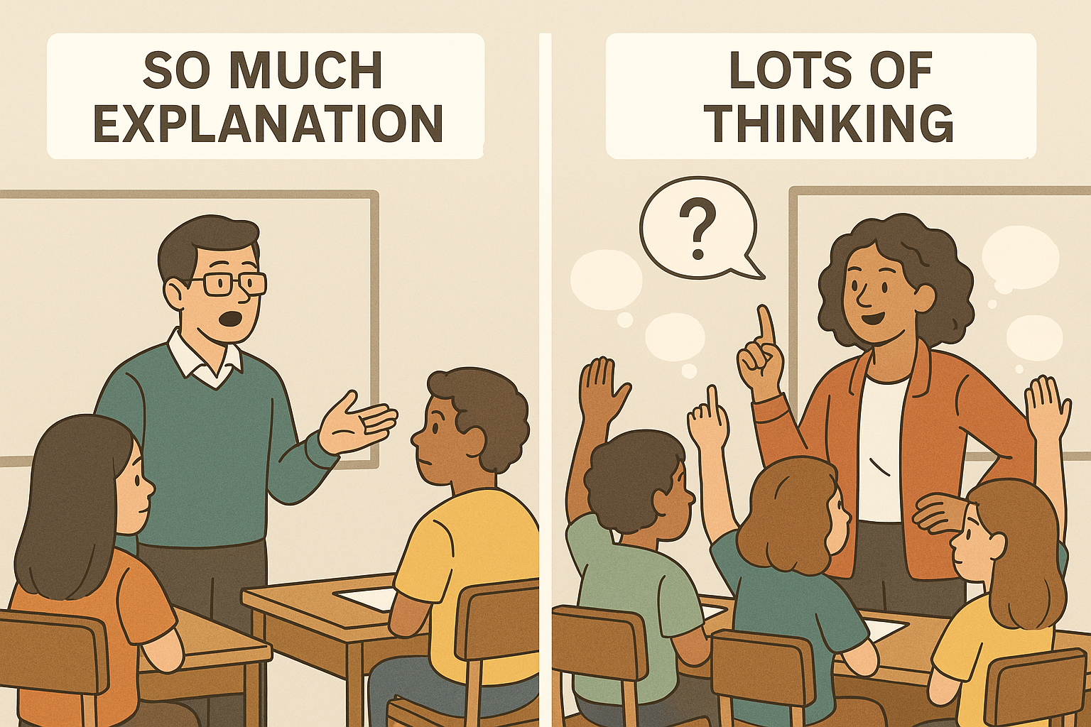
Turn Explanations Into Mini-Inquiries
Notes:
I don’t mean we should stop explaining things.
But we can shift from explaining too much to inviting inquiry —
turning explanations into opportunities for students to think, predict, and make sense of ideas themselves.
For the parts that truly need teacher explanation, we can insert micro moments of curiosity:
“Before I show you what happens, what do you think?”
“If I change this one thing, how do you think it will affect the result?”
“Why do you think scientists cared about this question?”
This keeps students mentally inside the phenomenon space, even during teacher-led instruction.
What comes to your mind when you hear “phenomenon space”?

Slide 25
Reflection
- How can you integrate one small PBL element into your next lesson?
- What science concept could connect to a real-world challenge?
- What support or collaboration would help you get started?
Notes:
For example: instead of teaching “Newton’s Laws” as isolated content, the class explores “Why does a skateboard slow down?”
That skateboard scenario becomes the phenomenon — and the classroom becomes the phenomenon space where students investigate, model, and reason around it.
So, instead of saying “We’re teaching about molecules,”
we say “We’re investigating why ice melts faster on metal than on plastic.”
That shift creates a phenomenon space where molecular ideas naturally develop.
“We’re not removing instruction — we’re transforming it.
The goal is to talk less: to open space for students to think, connect, and reason.”
What else can we try in the classroom to reduce teacher talk?
What can we put in place instead of heavy teacher talk to make learning more student-centered?

Slide 26
"Hands-on learning is not enough — we want minds-on learning that builds curiosity, reasoning, and creativity."
Notes:
The main reason I wanted to meet with you first is because you are already doing most — if not all — of these things so well. You only need a few small improvements, and for that reason, I want to sincerely thank you all for your dedication and hard work.
I need your collaboration to help move TMSA schools toward a culture where science discourse becomes a central part of learning. What do you say?
As I mentioned, the next step is this: you are already very rich in terms of content, and that’s great. I have now prepared a two-page document that will help train ChatGPT for your lessons.
What I’m asking is that, for each lesson, you send this template to ChatGPT and then follow the instructional suggestions it provides to guide your lesson.
Can we start from there?
From now on, I promise you won’t be as tired in class as before.
These ideas may seem simple and straightforward, but in reality, they’re not — they take time, reflection, and consistent practice. What we’re talking about is deeper and more abstract; it’s about changing the way we think about teaching and learning.
As we move forward, you’ll try new strategies, I’ll keep visiting and giving you feedback, and together we’ll keep learning from what happens in the classroom.
Through this process, we’ll build something truly powerful — a pedagogy that reflects who we are and what we believe about science learning.

Slide 27
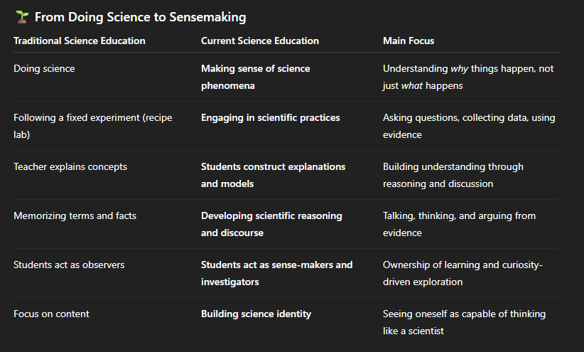
Notes:
Did you realize that in these lessons, there is no direct instruction?
Students have already experienced these phenomena in their everyday lives in a non-scientific way. Our role as teachers is not to define or explain those concepts for them, but to guide them toward making scientific sense of what they already know.
We do this not through definitions, but through questions — questions that help them connect, reason, and construct understanding, such as:
“What makes you think that?”
“Why do you think that happened?”
“What evidence do you have?”
“How could we find out?”
This approach shifts the focus from teaching science to making sense of science — where students are the thinkers, and teachers are the facilitators of meaning-making.

